Slide 1
Elizabethan society & world view

Slide 2
The Great Chain of Being
All creation linked together in hierarchical order
Important to keep one’s place, or one could upset all creation
The chain was linked from the lowest creature on earth up to God
The gravest sin to an Elizabethan was rebellion: stepping out of one’s place was upsetting the natural order

Slide 3
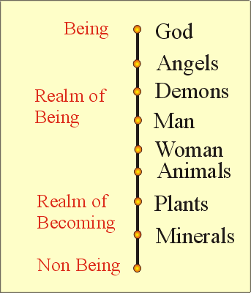

Slide 4
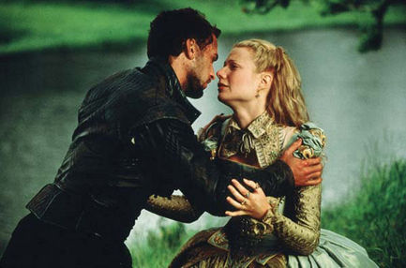
Social Imperatives for Elizabethan Women
Silence
Obedience
Chastity (or fidelity if married)

Slide 5
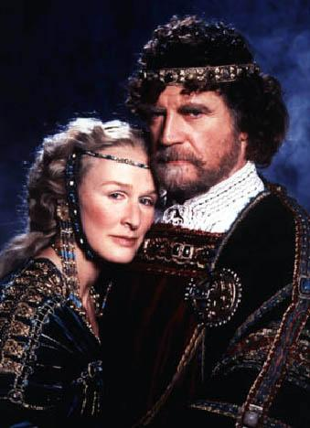
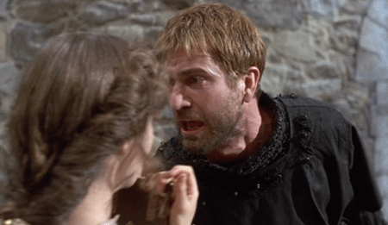
In Elsinore the Toilet Seats are Always Left Up

Slide 6
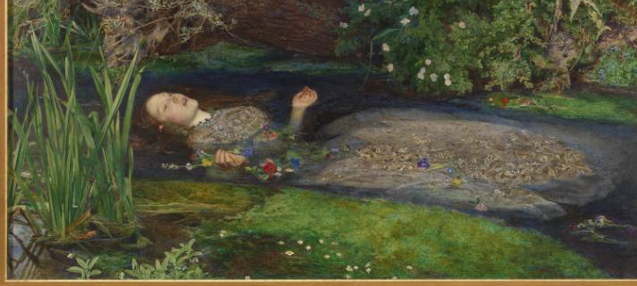
Irony of Shakespearean Women
Whether they try to conform to their societal role or whether they try to break it, they end up dead.

Slide 7
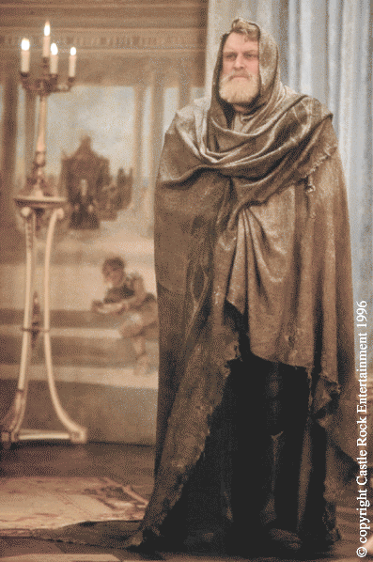
Elizabethan Beliefs About Ghosts
They would look like they did at the point of death.
Not everyone could see a ghost
A ghost would not appear during the day or during a holy season

Slide 8
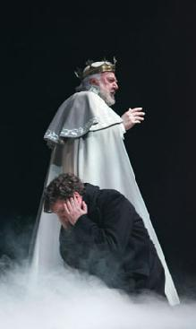
A ghost could not speak until spoken to.
It should be addressed in Latin.
A ghost could be a demon taking the form of a departed loved one to tempt you down the wrong path.

Slide 9
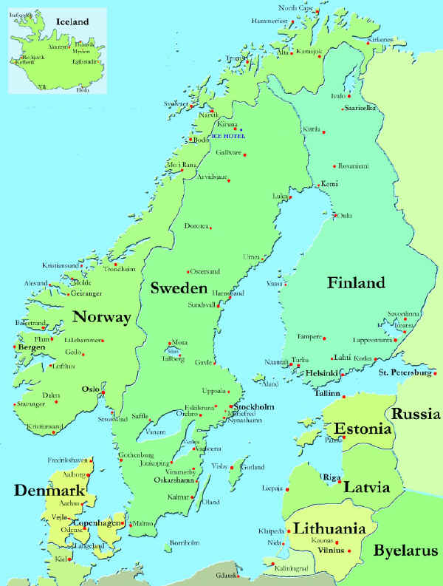
Hamlet
Set in medieval times
Hamlet the elder is King of Denmark
Old Fortinbras is King of Norway
Rivals re: border expansion

Slide 10
King Hamlet and King Fortinbras fight a duel over a piece of land.
The outcome of the duel was to accepted by both countries with no battle following.
Denmark defeats Norway:
King Hamlet kills King Fortinbras.

Slide 11
A short time later, back in Denmark at the royal castle Elsinore.
King Hamlet dies suddenly one night.
The death of Hamlet is explained as a snakebite while the king was sleeping in his garden.

Slide 12
Very soon after the death of her husband, Queen Gertude marries King Hamlet’s brother, Claudius, who has become king

Slide 13
