Slide 1
Current Trends in the Development of the English Language

Slide 2
Globalization of English
English is becoming the global language of commerce, science, engineering, entertainment and the internet

Slide 3
Vastness of English Vocabulary
English vocabulary is larger than most languages
Words are multiplying:
Coined words, language of science and the internet
Usually at least 3 words for any idea:
Eg. Human habitation: city, town, metropolis, village

Slide 4
English language changes with great speed
English has 1 000 000 words
Spanish 250 000 words
German 185 000
French 100 000
Source: A Million Words and Counting (145)

Slide 5
Sources of English words:
The Bible contains about 20 000 different words
Shakespeare’s works use 24 000 different words; he invented 1 700 of them

Slide 6
Sources of New Words
Science and technology (eg. The internet: bandwidth, cookies, megapixels)
Brand Names: eg. iPod, Xbox
Domain names: over 75 000 domain names exist and creep into your language (eg. Youtube)
Media and the Entertainment industry:
“Oh snap!” (from Freaky Friday)

Slide 7
Political and Social Trends:
“Herstory”: tries to remove the male element from “history”
“Menaissance”: the rise of a “manliness” culture or male renaissance
Waitron: a waiter or waitress

Slide 8
The Influence of Foreign Speakers:
“No noising”—Quiet, pleas (Chinglish)
“Drinktea”—coffee break (Chinglish)
“Marqueta”—grocery store (Spanglish)

Slide 9
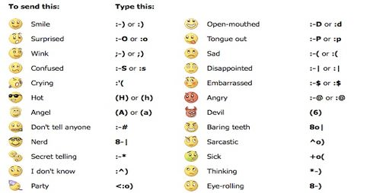
Text Messages and Electronic Language:
The emoticon

Slide 10
How a word becomes Part of the Language:
Usage sometimes determines acceptance
Dictionaries are, by their nature, descriptive rather than prescriptive
e.g. “ginormous”

Slide 11
What Experts Predict for the Futures of the English Language:
1. English will evolve into various “lishes” (eg. Chinglish, Hinglish, Spanglish, etc.)—English will be spoken by billions of people
2. An internationally standardized form of English becomes accepted, and assists globalization

