Slide 1
Killing the 5 Paragraph Essay

Slide 2
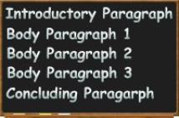
The five paragraph essay focuses on form rather than reasoning.
It is formulaic.
Does not promote analytical thinking.
Good writing must be engaging…
Good for entry-level… but not 4U

Slide 3
The problem is the 5 paragraph essay

Slide 4
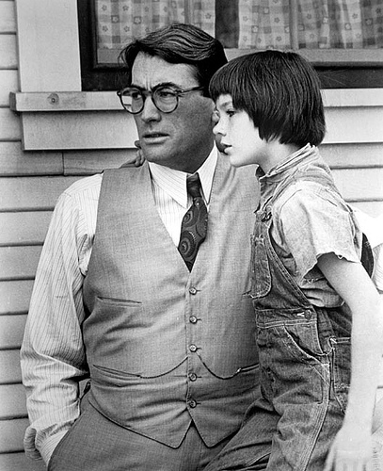
The Thesis Statement
Most high school thesis statements are merely observational.
Scout sees racism all around her and understands what it means to walk in another person’s shoes.
Yes…yes, she does.

Slide 5
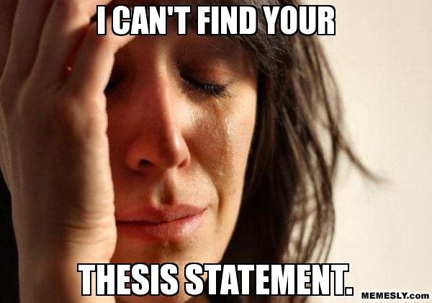
There is nothing debatable here.
A good thesis statement should be debatable.
specific topic
+ debatable view
+ significance to the audience

Slide 6
Cause & Effect
By building an essay around analytical thinking you can create a stronger essay.
What are the causes? This is merely observational. Identify these causes.
Then specifically note how one such cause brings about an intended effect.
(This is the debatable part!)

Slide 7
Good thesis statements
Although the characters in Three Day Road have developed a sense of identity throughout the text, their loss of innocence leads to an existential destruction of self.
Despite the obvious lack of parents in Three Day Road, there are several parental figures who help in the development of Elijah and Xavier’s psychological awareness.

Slide 8
If we accept Judith Butler’s theory that “Masculine and feminine gender roles are not biologically fixed but socially constructed”, then we must surmise that the war has constructed Xavier’s gender and “created” a gender role that in in contrast to Elijah’s.
Although, the native characters in Three Day Road come into the war as soldiers, the perceived idea of the “Noble Savage” allows them the freedom to thrive in and ultimately achieve a status beyond that of a mere “bush indian”.

Slide 9
Wait, I can’t answer that in 5 paragraphs! You’re right…you can’t.

Slide 10
Well, actually you probably can, but you are cheapening your argument.
Intro to the text and the main problem
Causes, and your thesis
(cause and effect that is most important)
Your cause in the text
(could be multiple paragraphs)
The effects of the cause
(should be multiple paragraphs)
Conclusion

Slide 11
Despite its widespread use, the traditional five-paragraph essay does not allow students to express ideas engagingly, proving that this structure limits students' writing development.
-Ray Salazar

